Slide 1
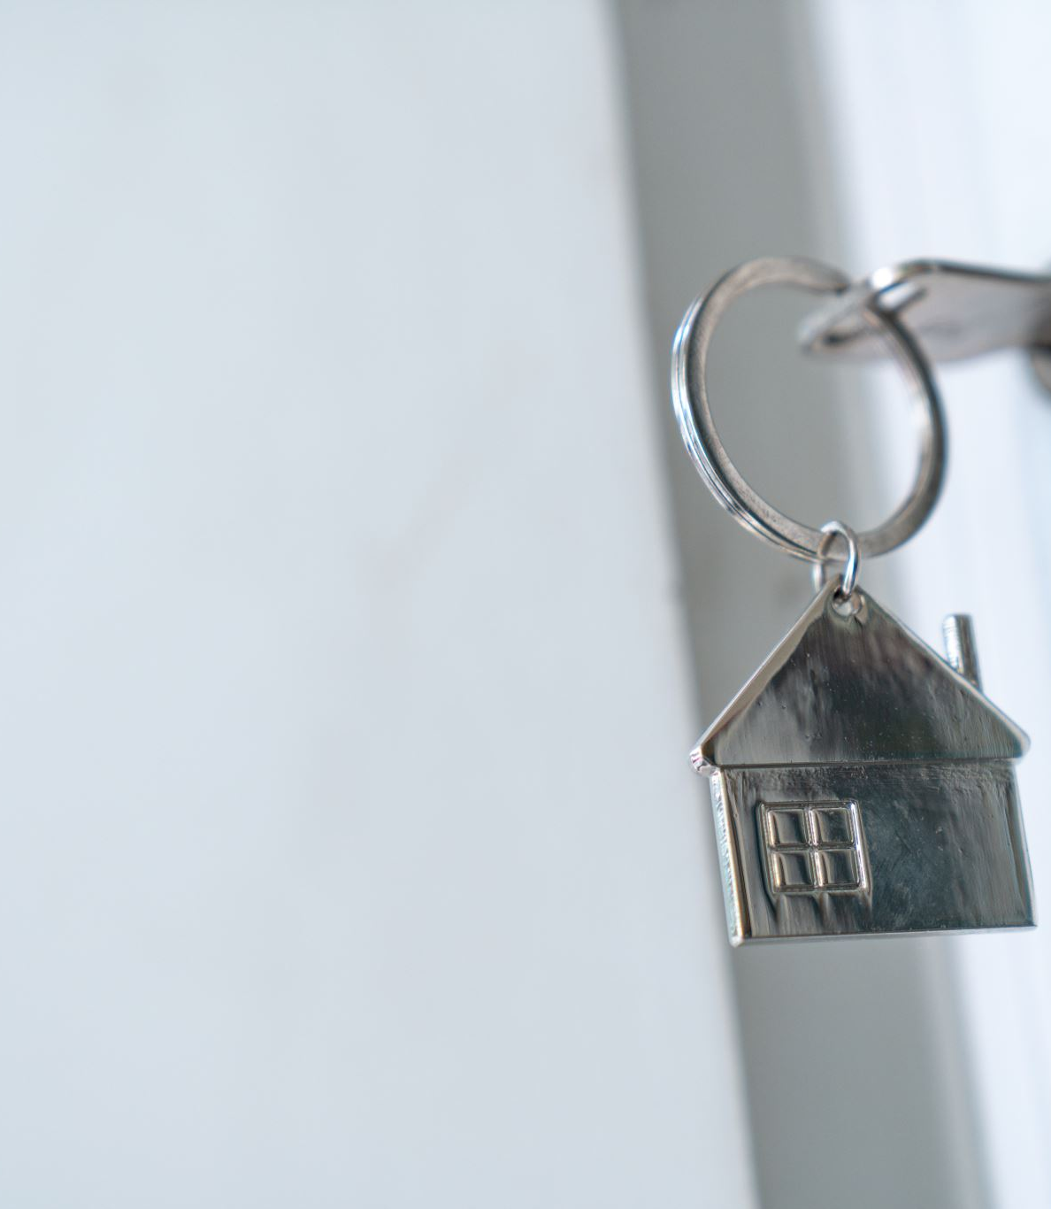
Smart Home Design

Slide 2

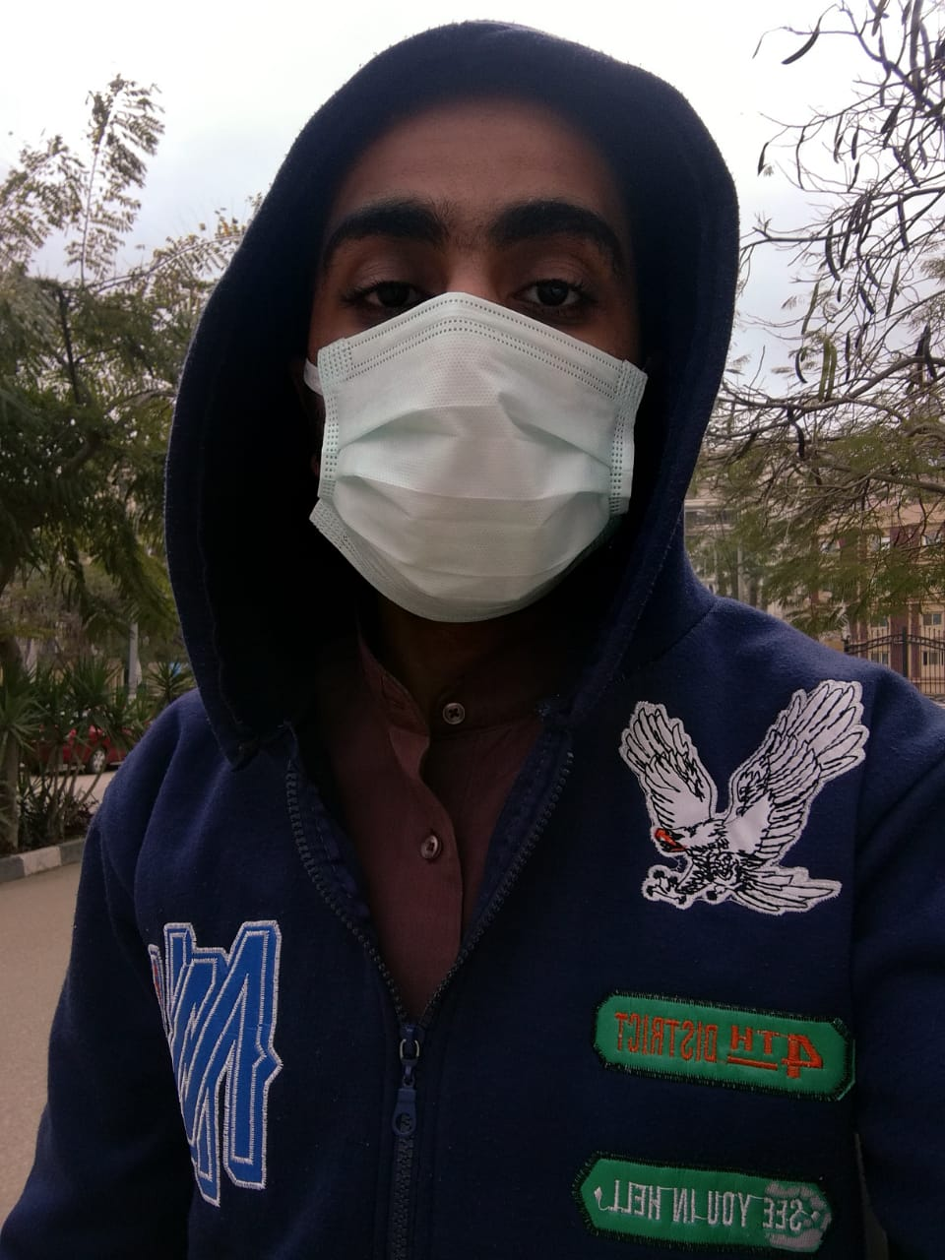

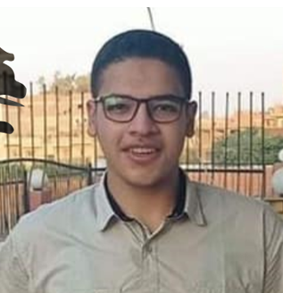
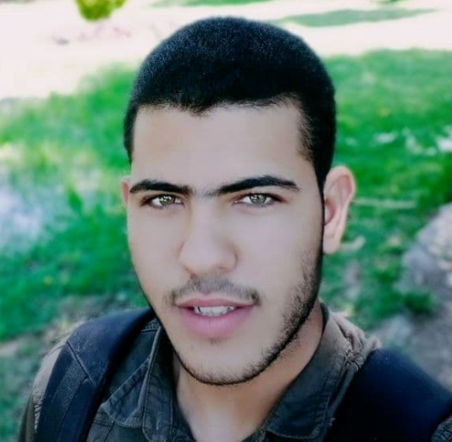
Team
عبدالحليم أسامة
عبدالخالق إبراهيم
زيدان محمد
Leader
Team member
Team member
Team member
طه رمضان
عاطف رضا
Team member
Team member

Slide 3
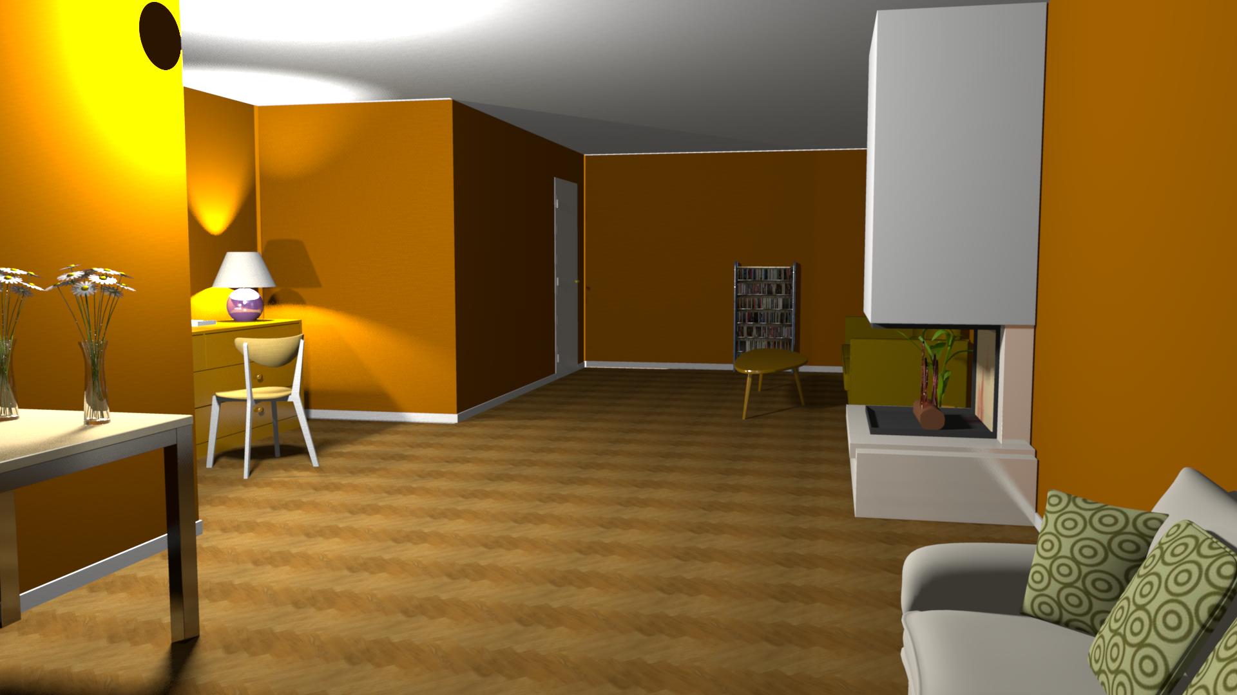
Baka
Copyright © by Halemo GPA All rights reserved.

Slide 4
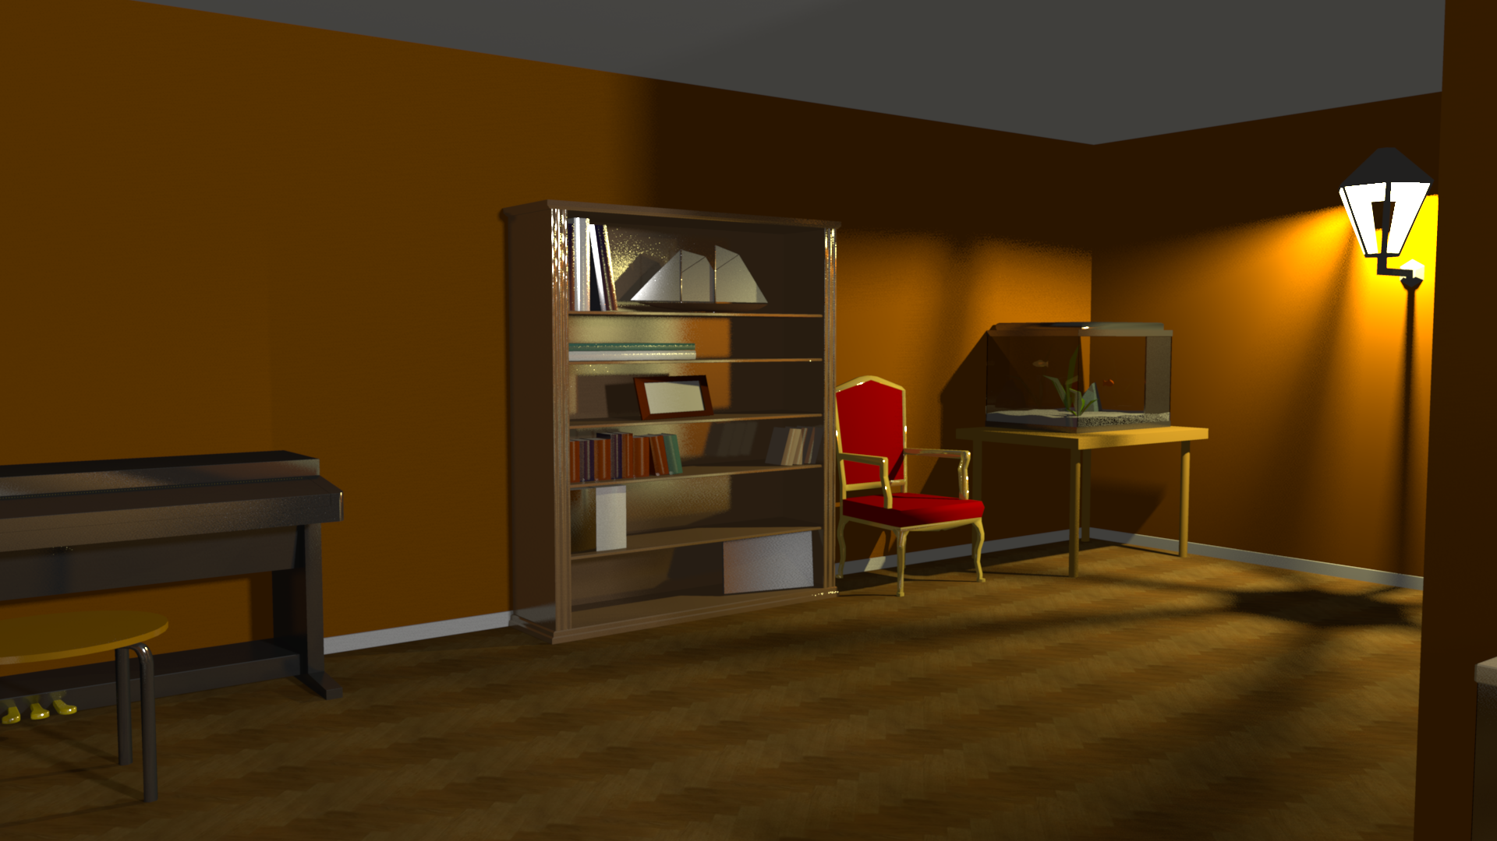
Baka
Copyright © by Halemo GPA All rights reserved.

Slide 5
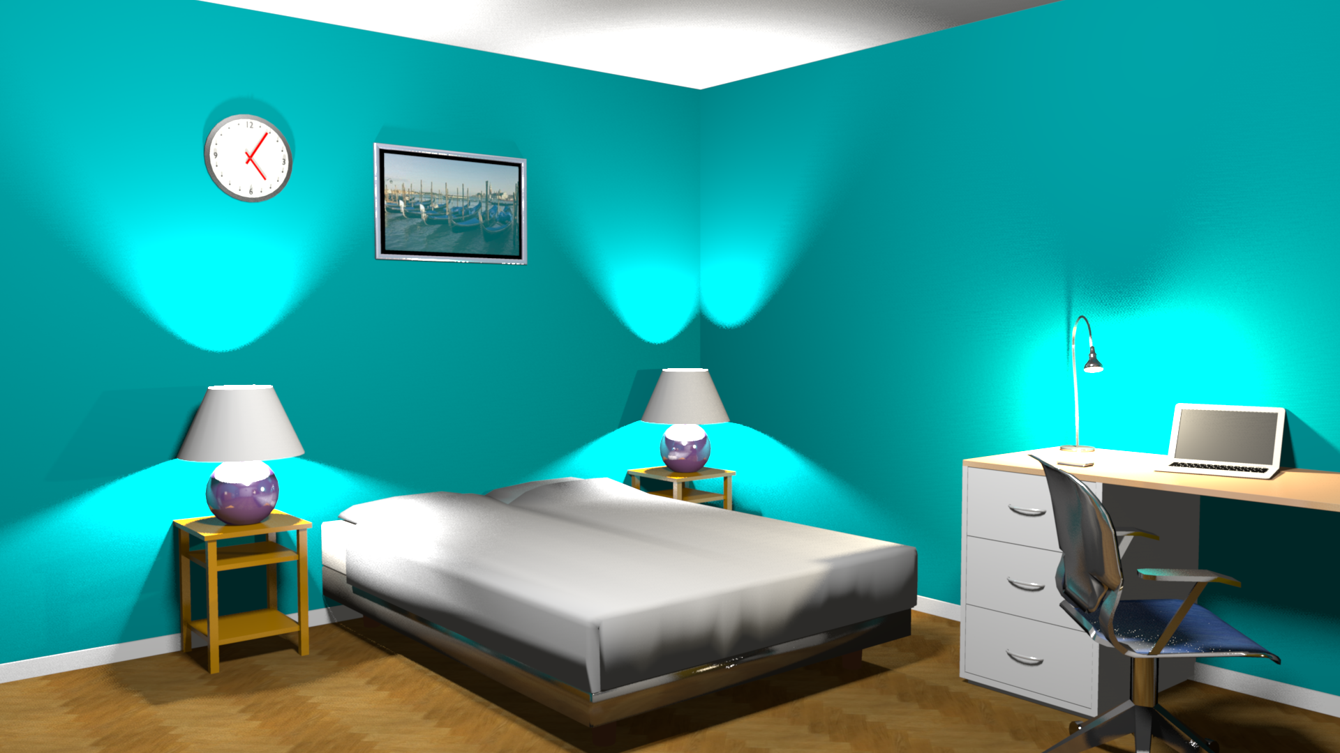
Baka
Copyright © by Halemo GPA All rights reserved.

Slide 6
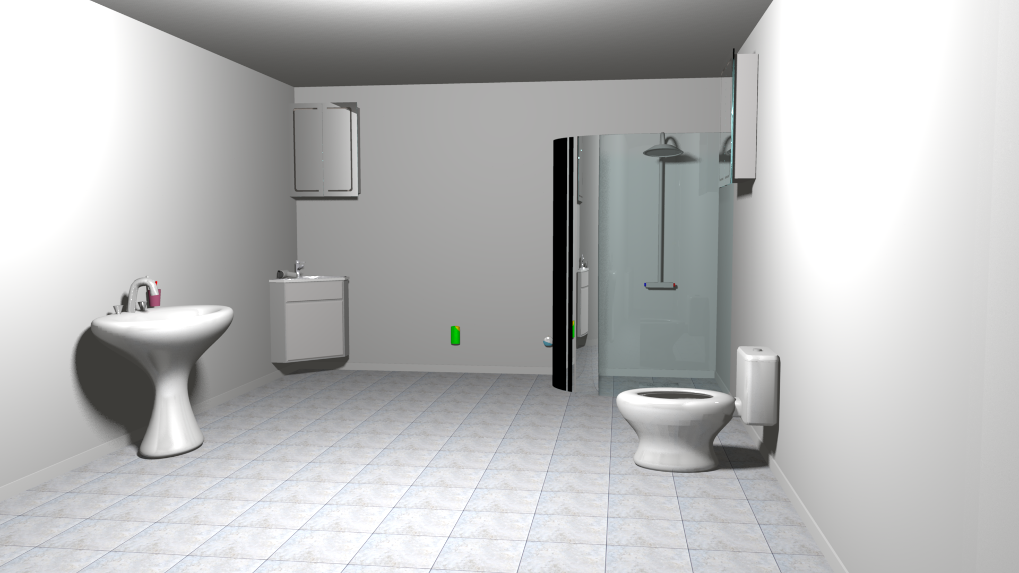
Baka
Copyright © by Halemo GPA All rights reserved.

Slide 7
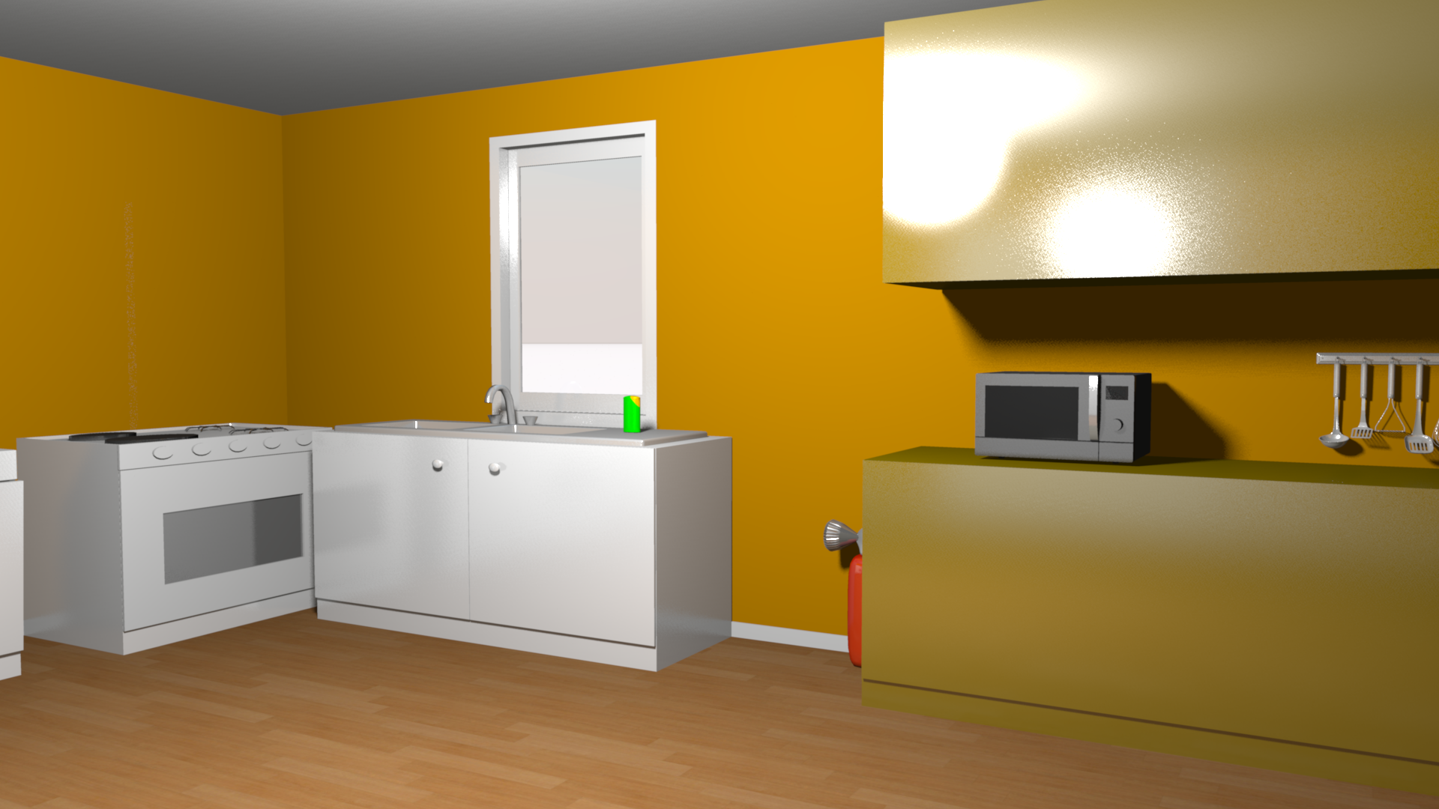
Baka
Copyright © by Halemo GPA All rights reserved.

Slide 8
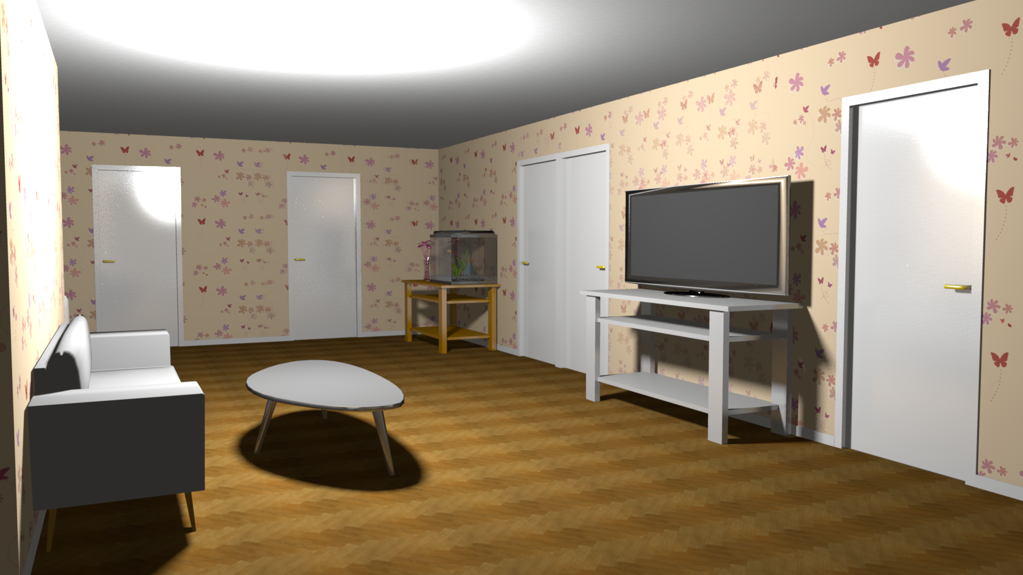
Baka
Copyright © by Halemo GPA All rights reserved.

Slide 9
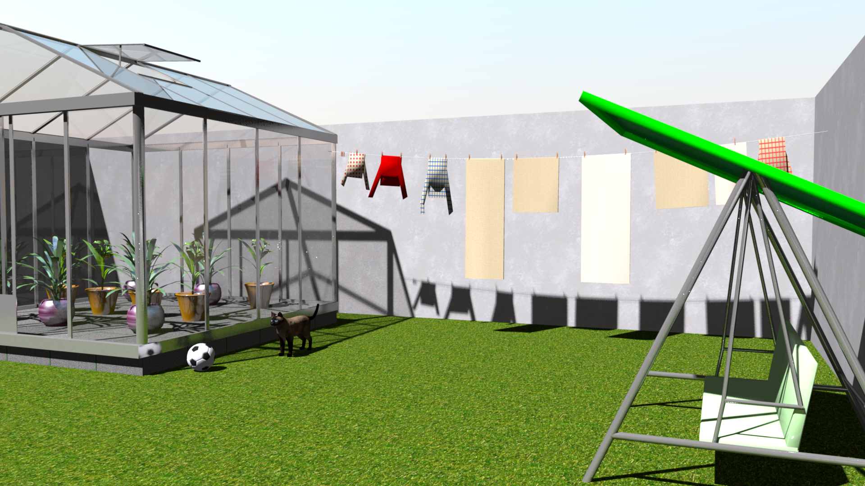
Baka
Copyright © by Halemo GPA All rights reserved.

Slide 10
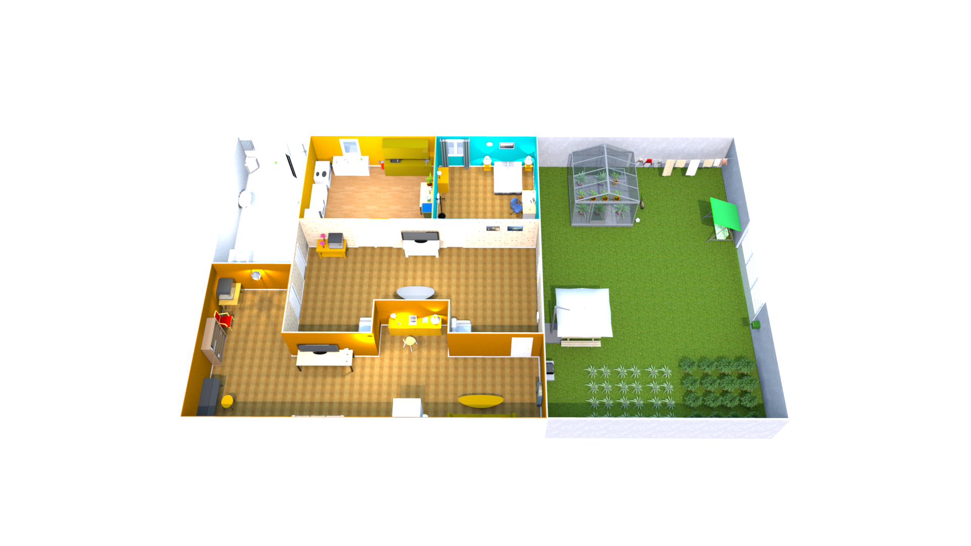
Baka
Copyright © by Halemo GPA All rights reserved.

Slide 11
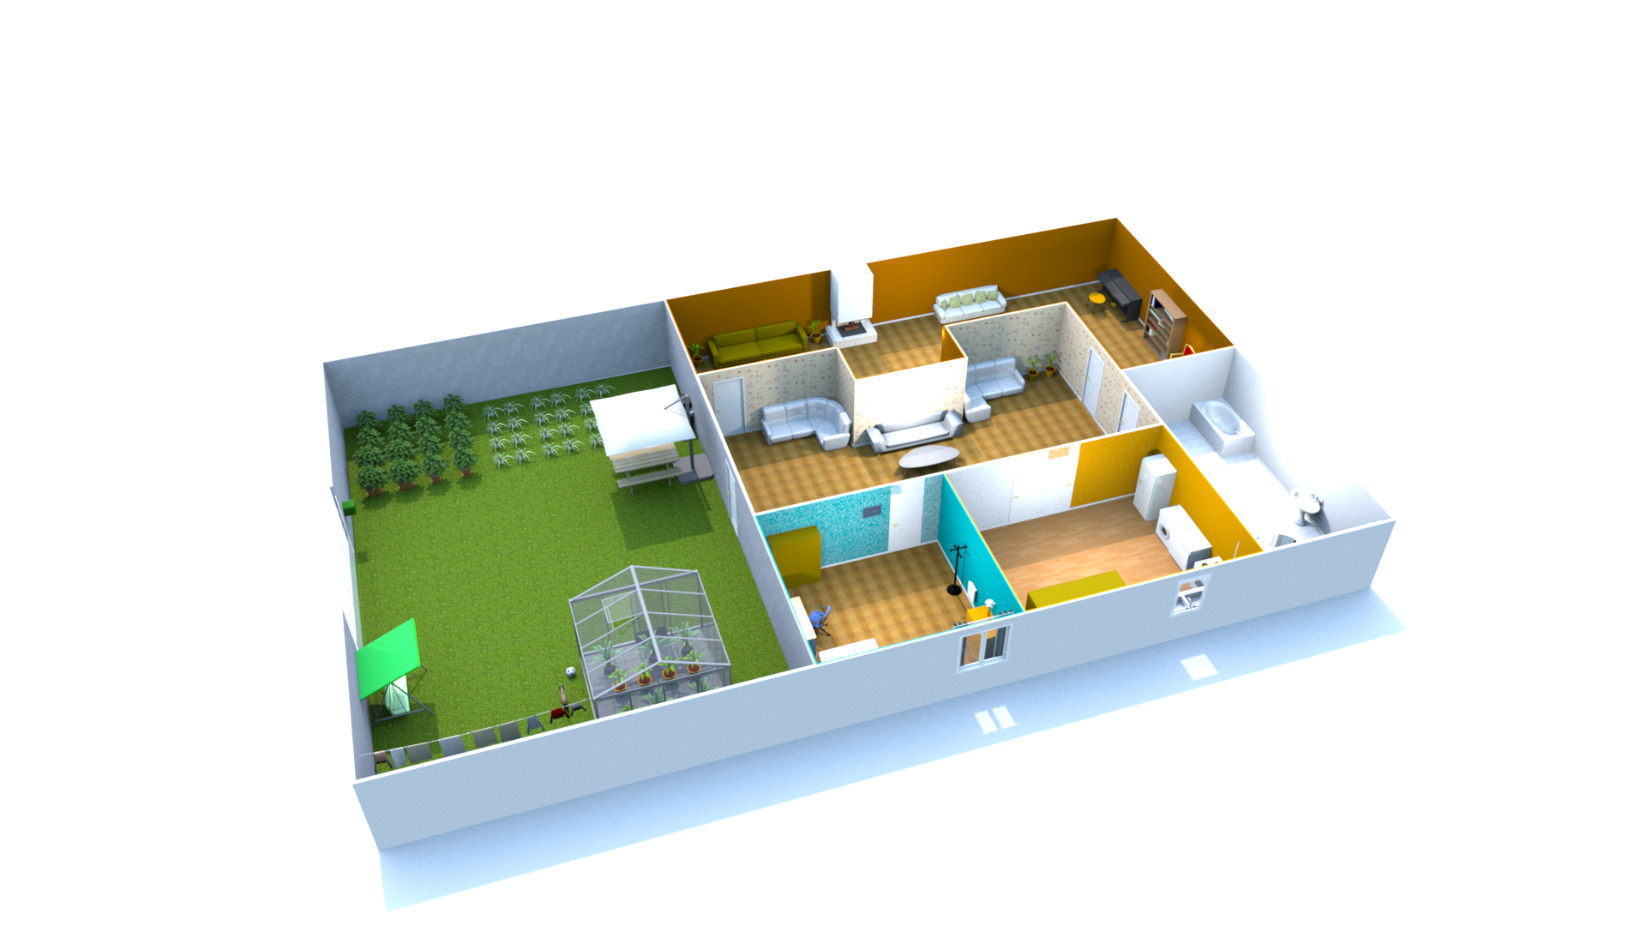
Baka
Copyright © by Halemo GPA All rights reserved.

Slide 12
Best View
Copyright © by Halemo GPA All rights reserved.

